Slide 1
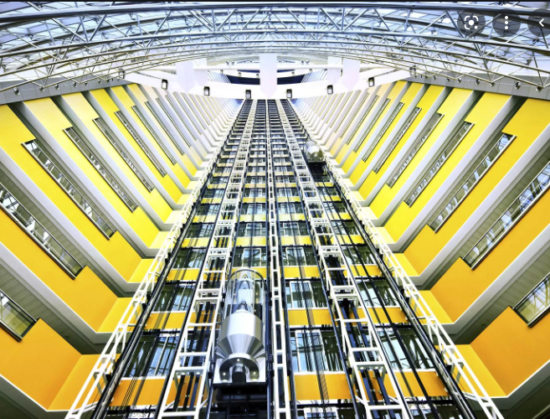
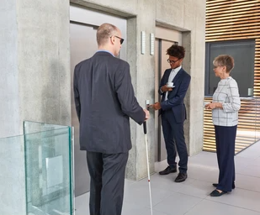
INTERACTION BETWEEN HUMANS AND THE REAL WORLD VIA A COMPUTER SYSTEM
REAL WORLD
HUMANS CANNOT DIRECTLY INTERACT WITH ELEVATOR SYSTEM
ELEVATOR CONTROL SYSTEM
US HUMANS

Slide 2

INTERACTION BETWEEN HUMANS AND THE REAL WORLD VIA A COMPUTER SYSTEM
REAL WORLD
HUMANS CANNOT DIRECTLY INTERACT WITH ELEVATOR SYSTEM
ELEVATOR CONTROL SYSTEM
US HUMANS

